Slide 1

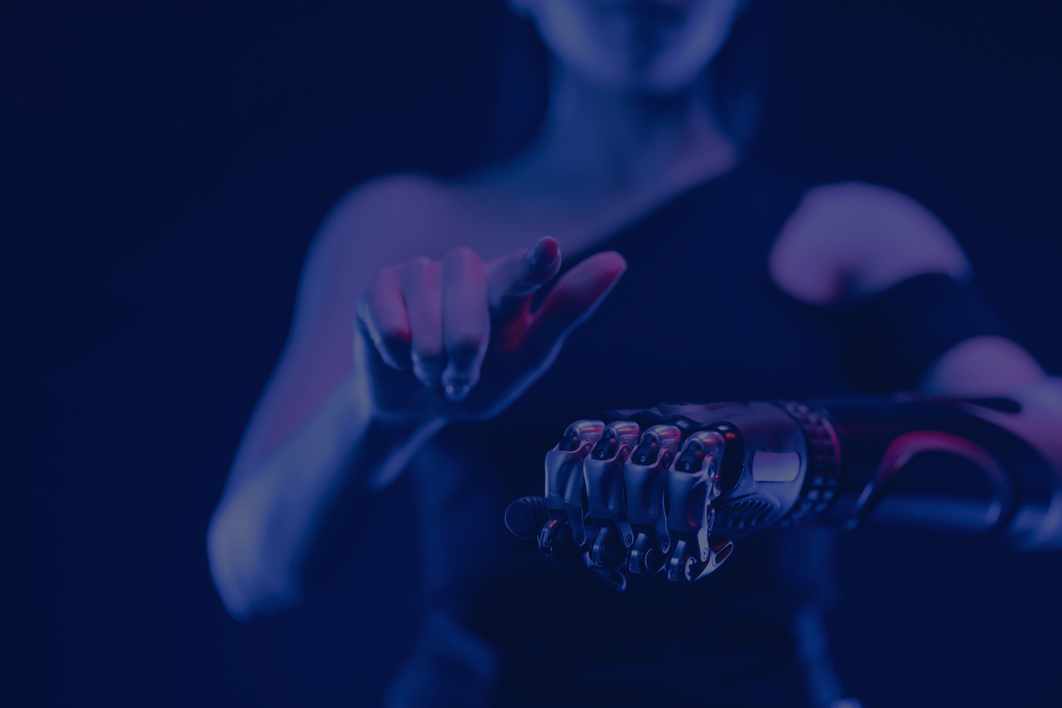
Personal virtual assistant
by Ujjwal

Slide 2
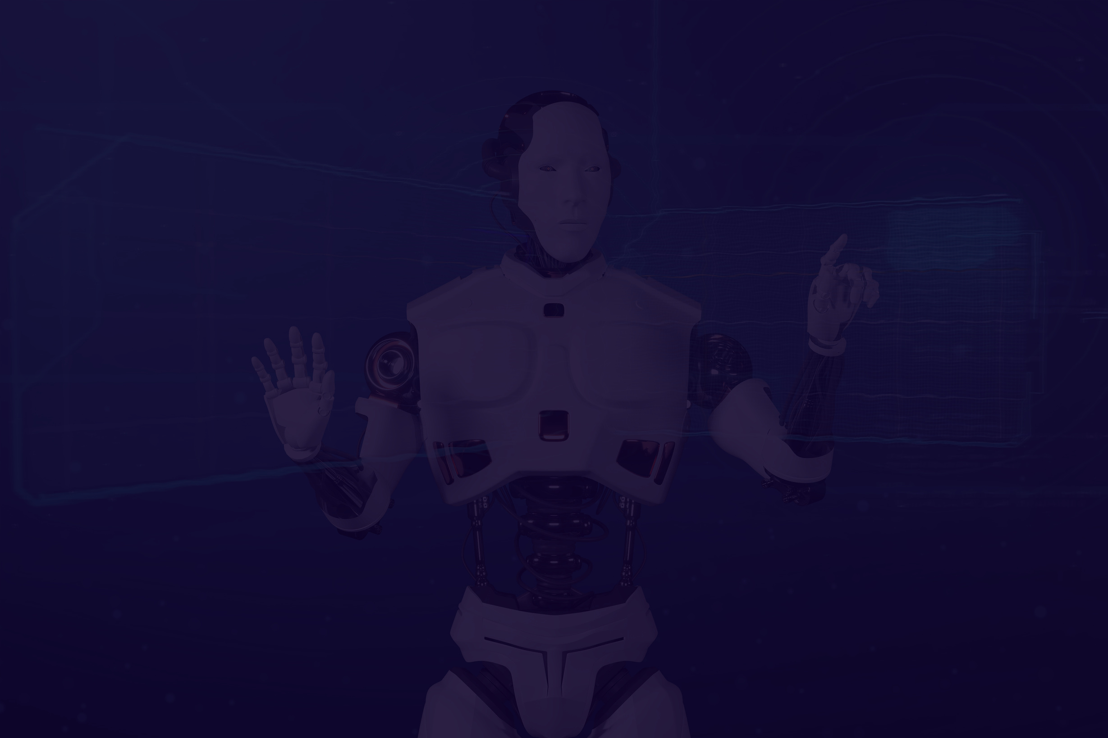
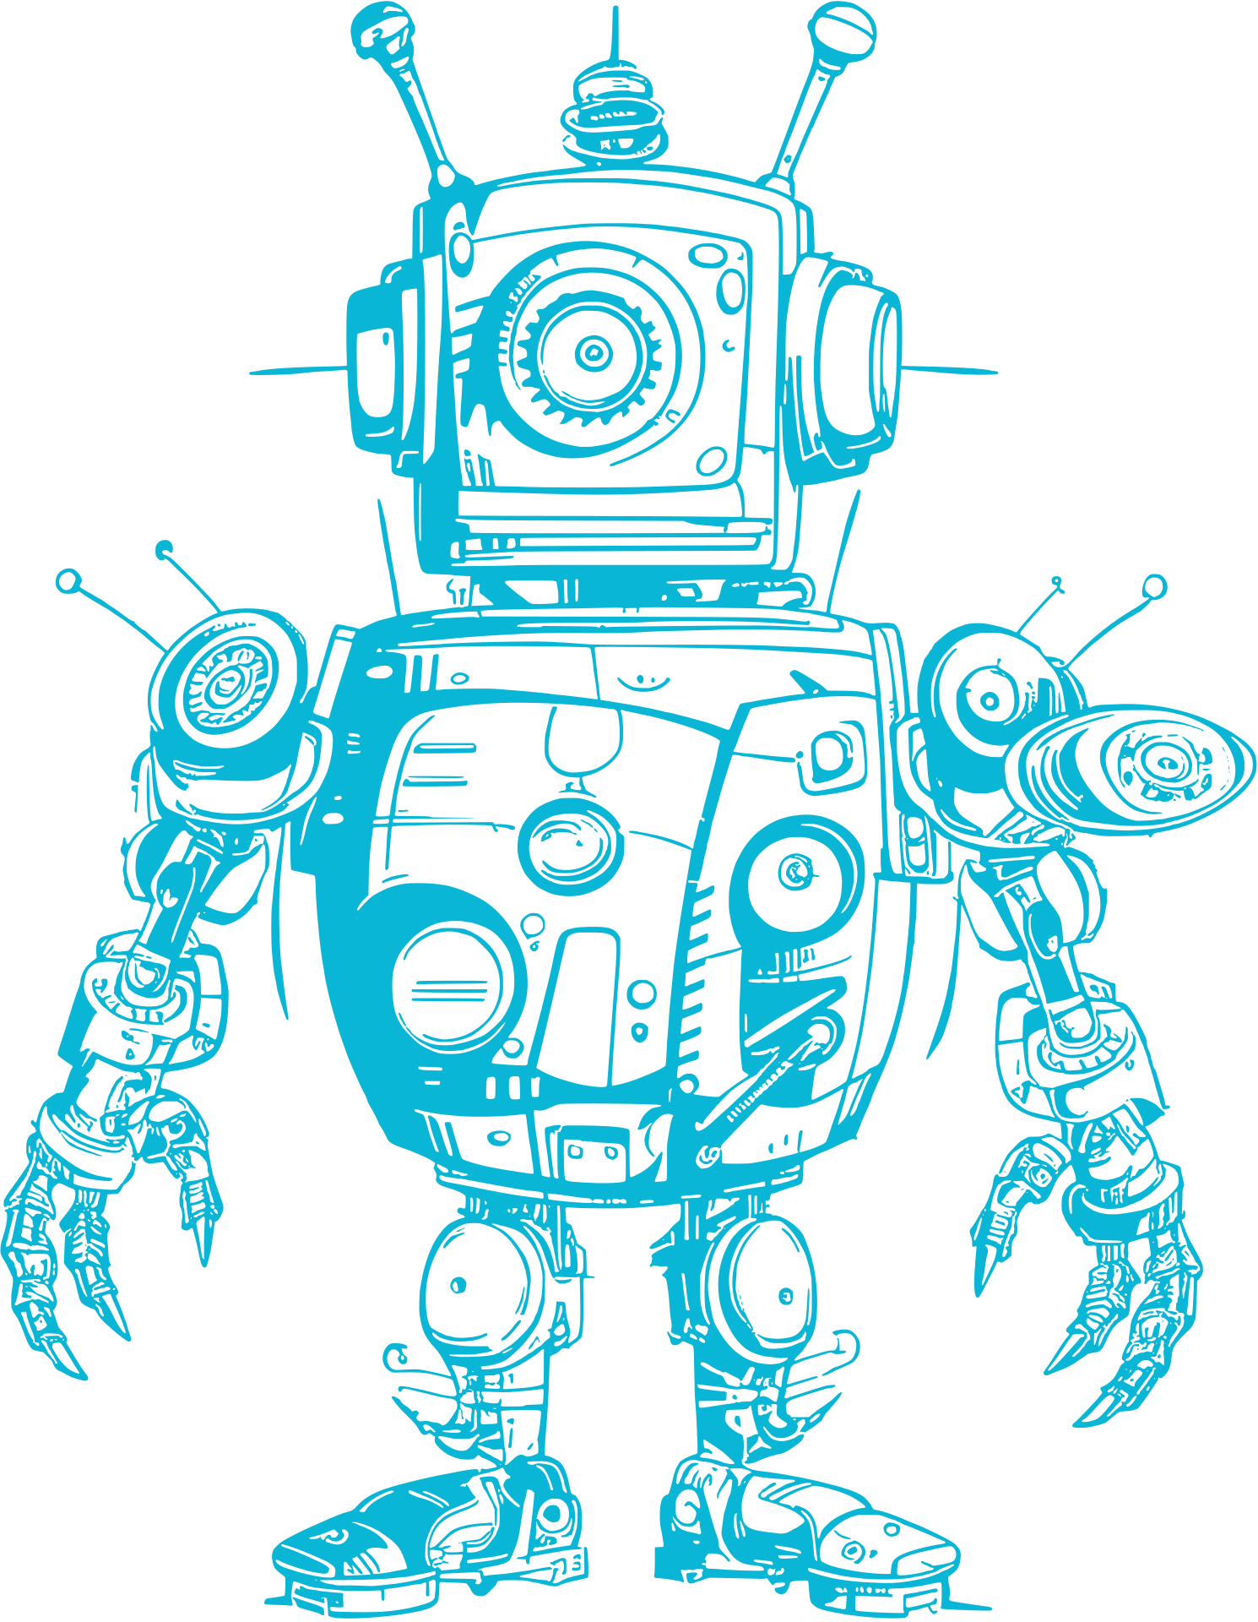

Project Overview
02
Virtual assistants are software programs that help you ease your day to day tasks, such as
showing weather reports, giving daily news, searching the internet etc. They can take
commands by voice. Voice-based intelligent assistants need an invoking word or wake word to
activate the listener, followed by the command. We have so many virtual assistants, such as
Apple’s Siri, Amazon’s Alexa and Microsoft’s Cortana and Amazon's Alexa and this has been
an inspiration for us to do this as a project. This system is designed to be used efficiently on
desktops.

Slide 3
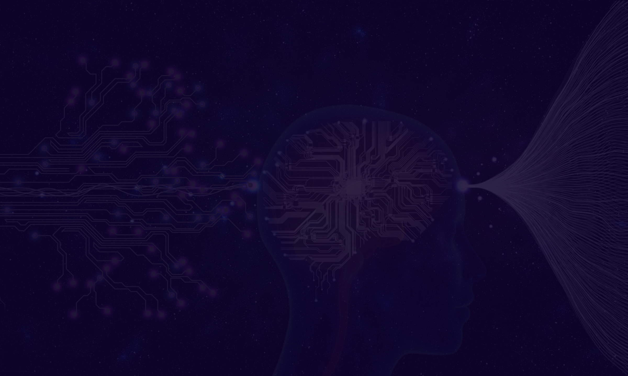
Technologies used :
Python:
Core language used to build the PC Assistant.
Its rich library ecosystem enables seamless integration with APIs and machine learning models.
2. Speech Recognition
Library Used: speech_recognition
Captures and converts user voice commands to text using Google Speech Recognition API.
3. Machine Learning
Algorithm: Naive Bayes (MultinomialNB)
Used for intent classification, mapping user queries to specific actions.
Library Used: scikit-learn
CountVectorizer: Converts text data into numerical vectors for classification.
MultinomialNB: A probabilistic classifier ideal for text-based tasks.
4. Text-to-Speech
Library Used: pyttsx3
Provides voice-based feedback to users.
Works offline and supports customizable voices.
5. Web Automation
Library Used: webbrowser
Dynamically opens websites based on user commands or searches.
6. File and System Management
Library Used: os
Handles file and folder creation, deletion, and system-level operations.
03

Slide 4
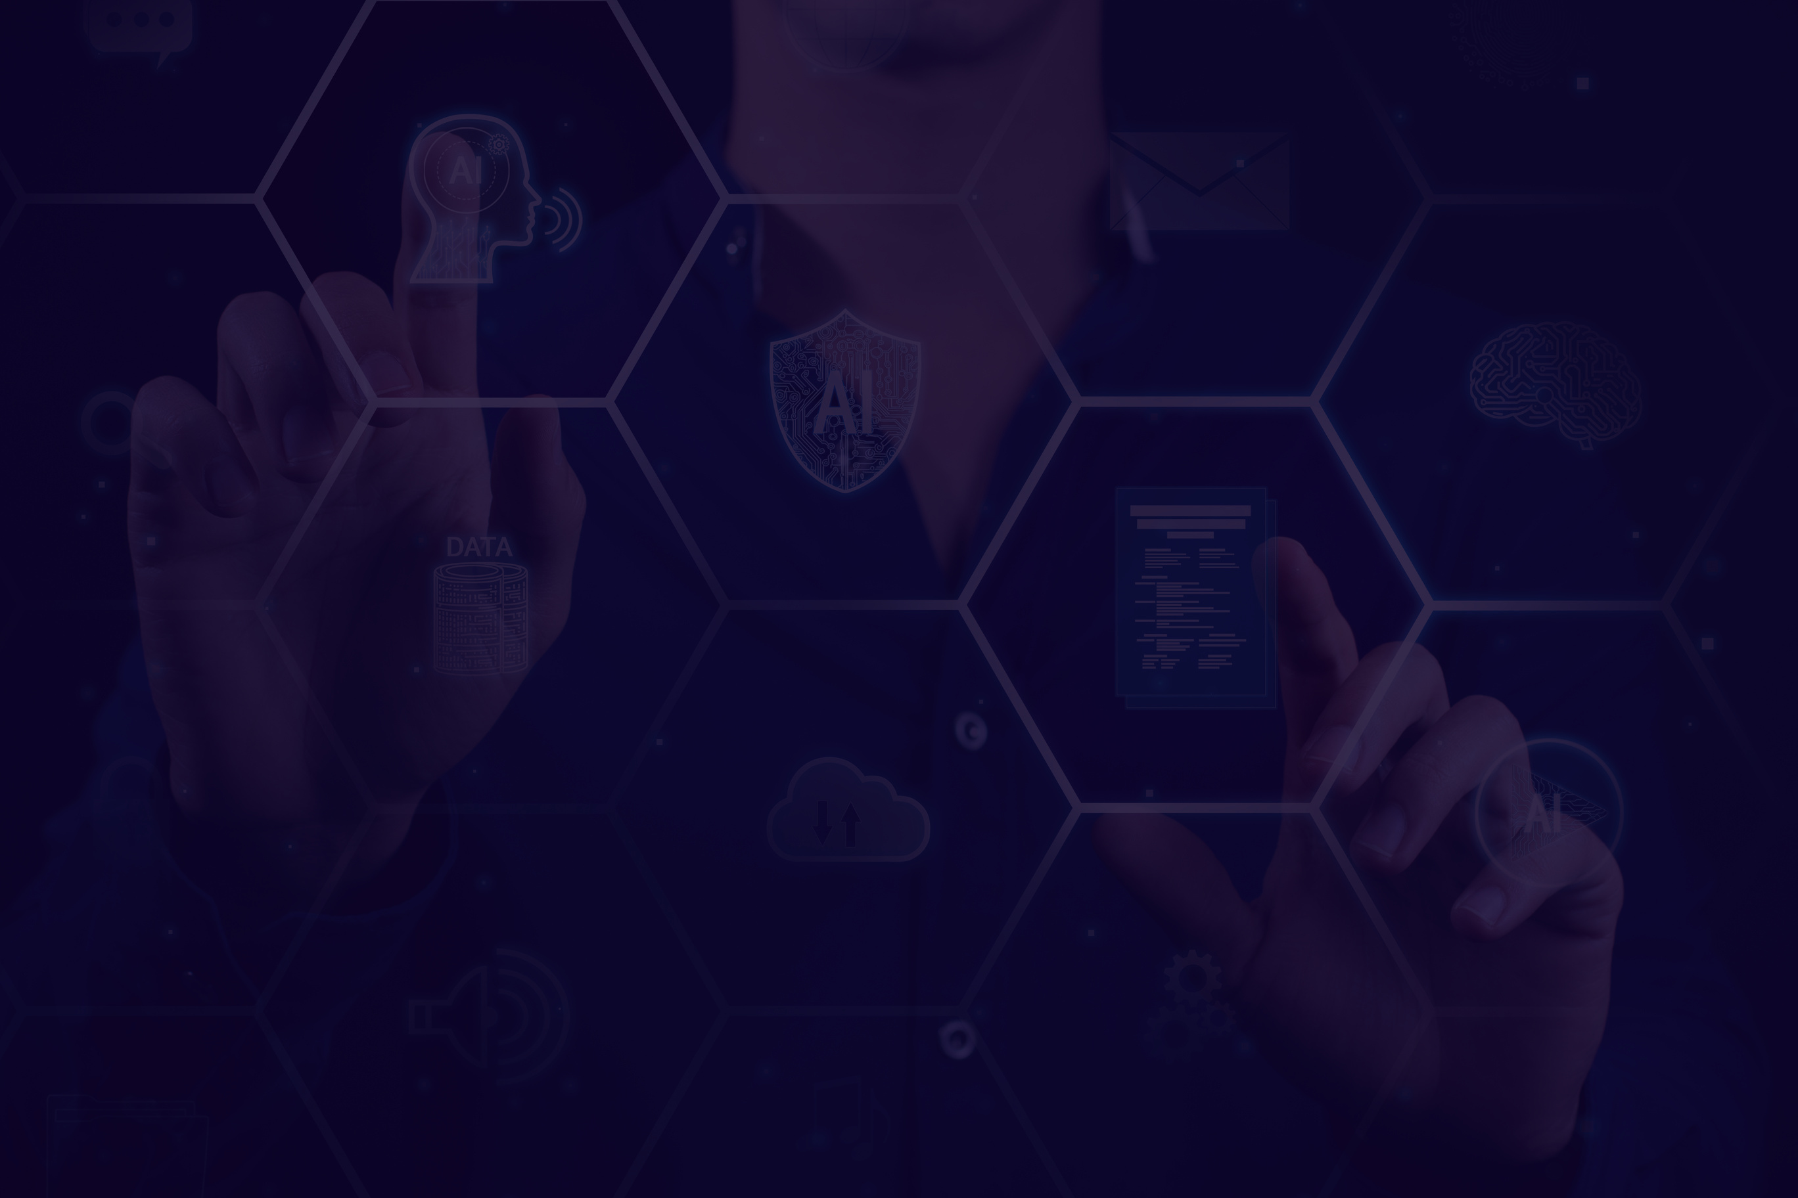
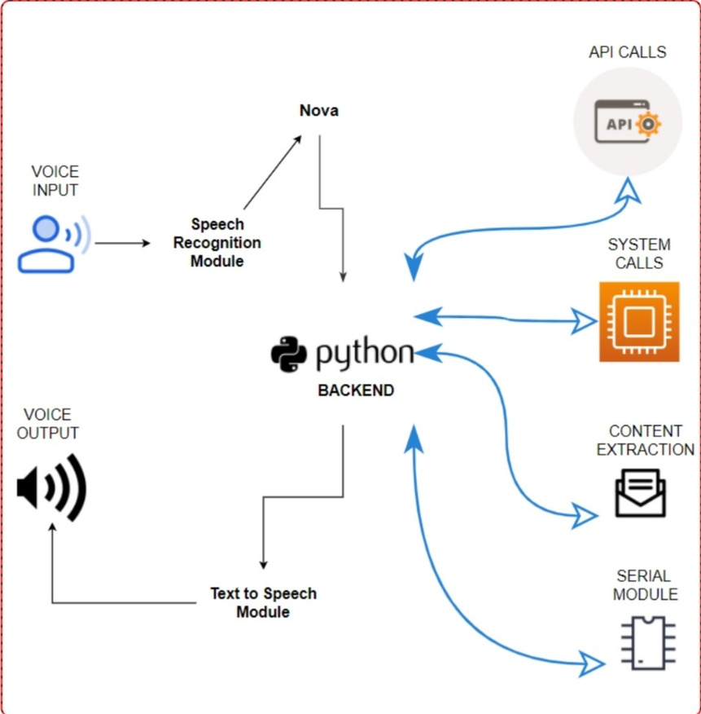
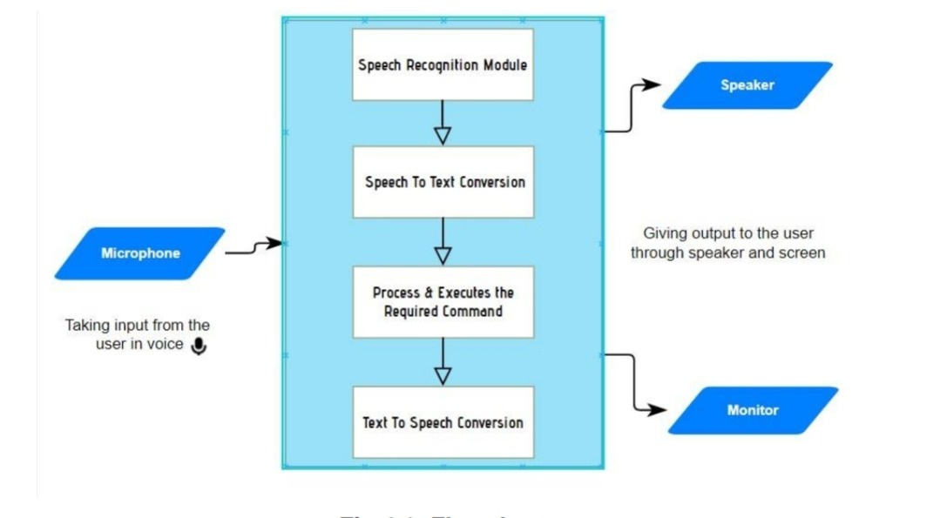
How it works:
04

Slide 5
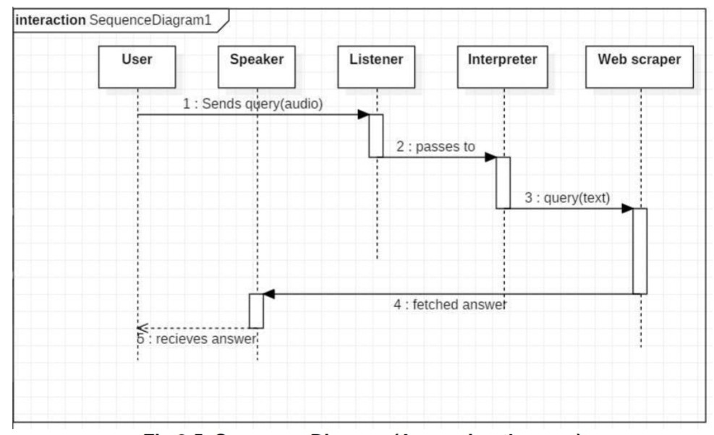
How it works:
04

Slide 6
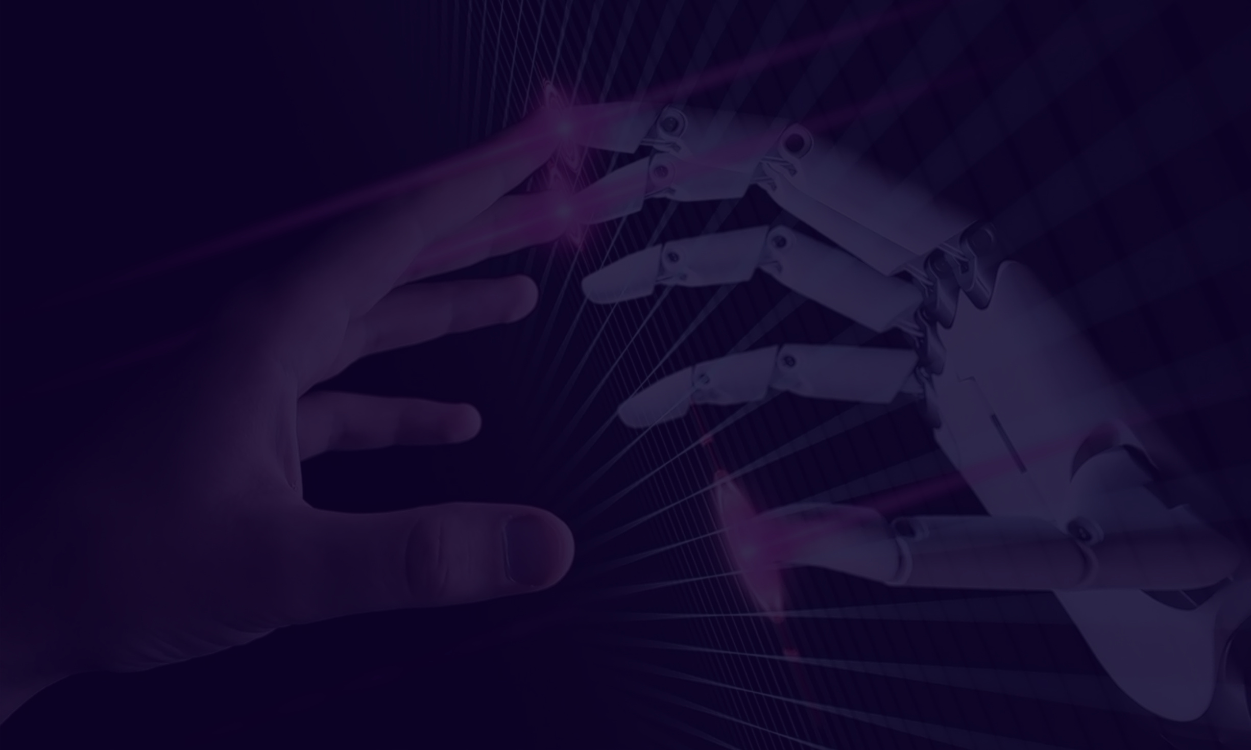
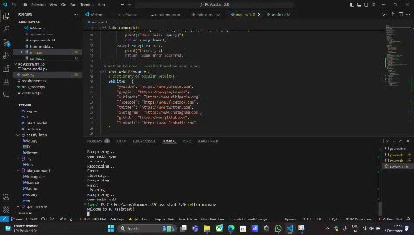
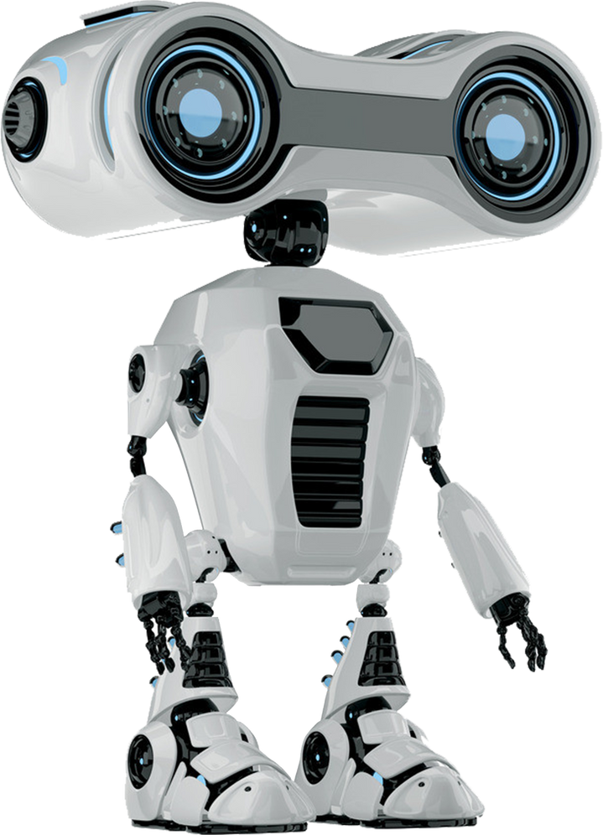
Demo video :
05

Slide 7

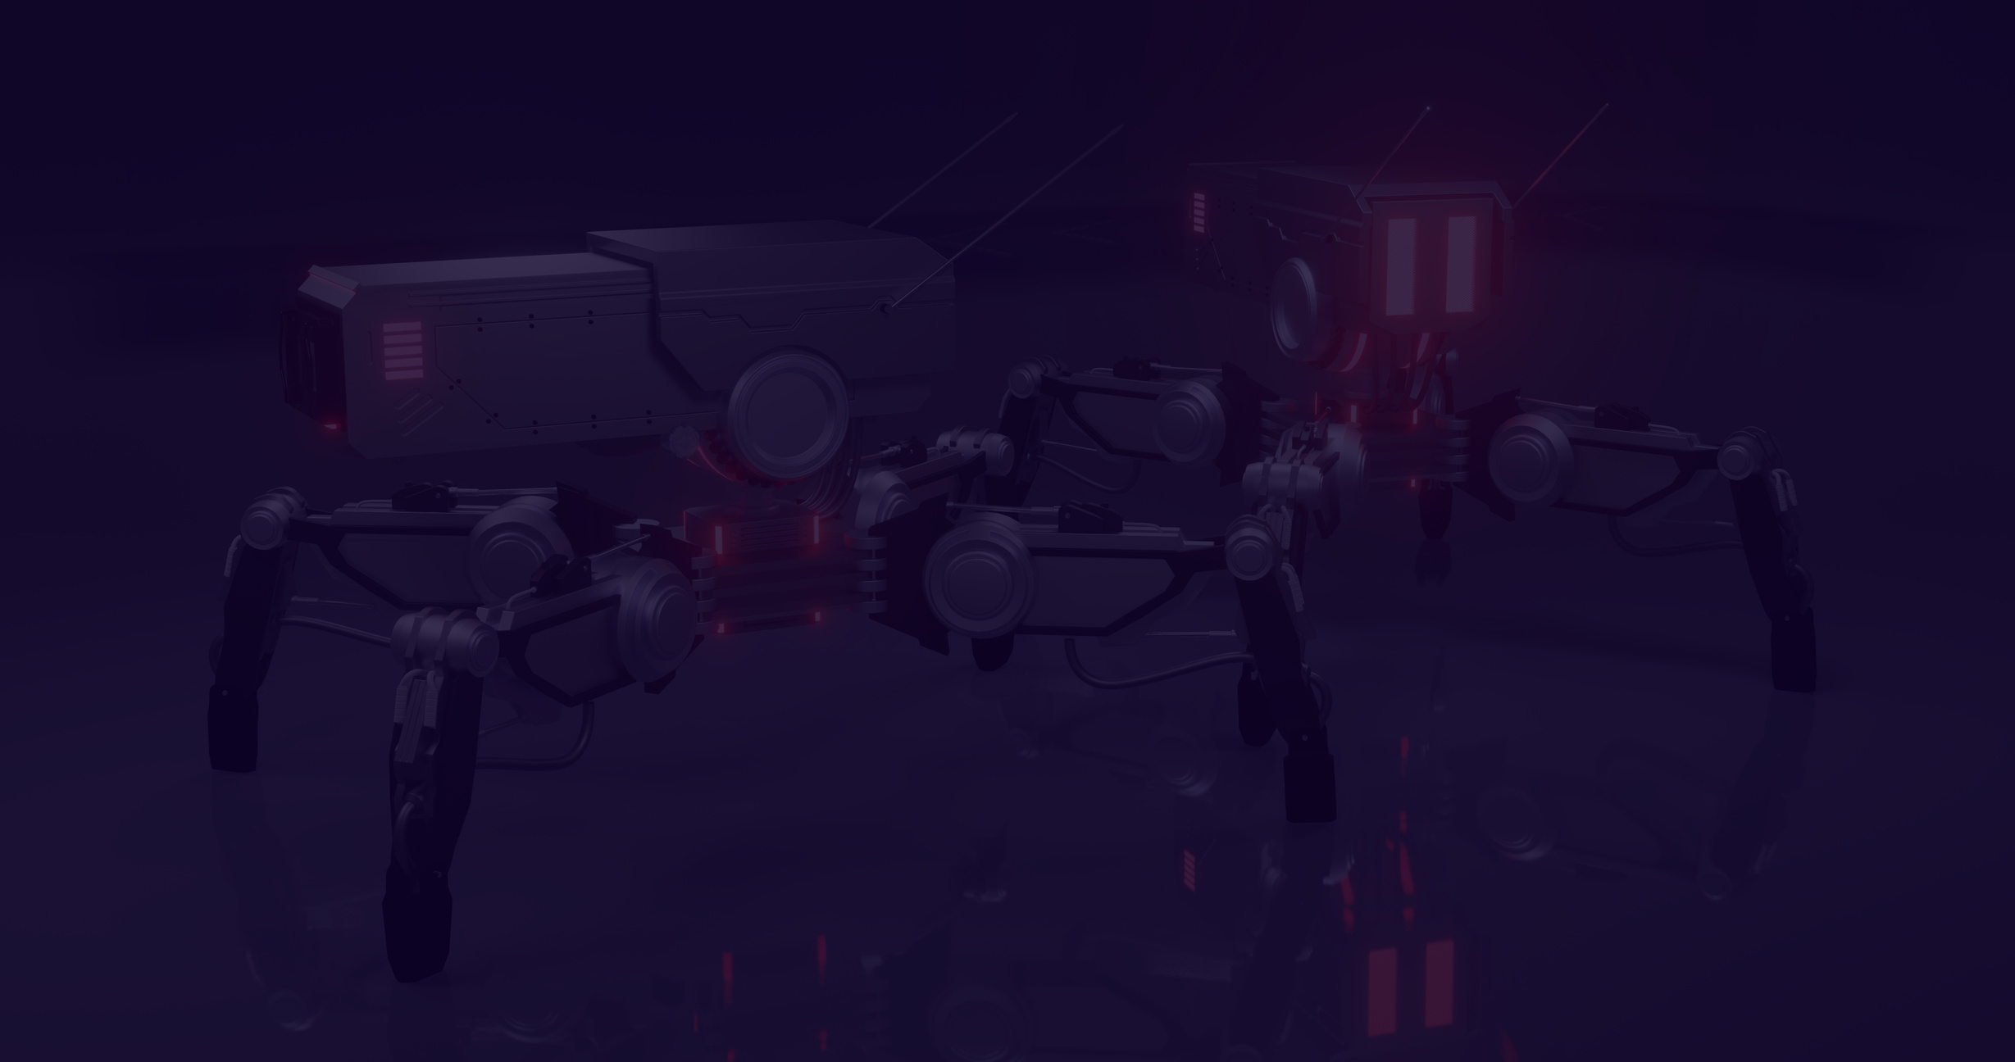

Features :
06
Voice Recognition:
Captures and processes voice commands using Google Speech API.
Intent Classification:
Uses Naive Bayes to determine user intent (e.g., open websites, start applications).
AI-Powered Responses:
Integrates OpenAI GPT-3 for intelligent, context-aware replies.
Dynamic Web Automation:
Opens predefined websites or performs Google searches.
Application Launching:
Starts system applications like Notepad, Calculator, and File Explorer.
File and Folder Management:

Slide 8

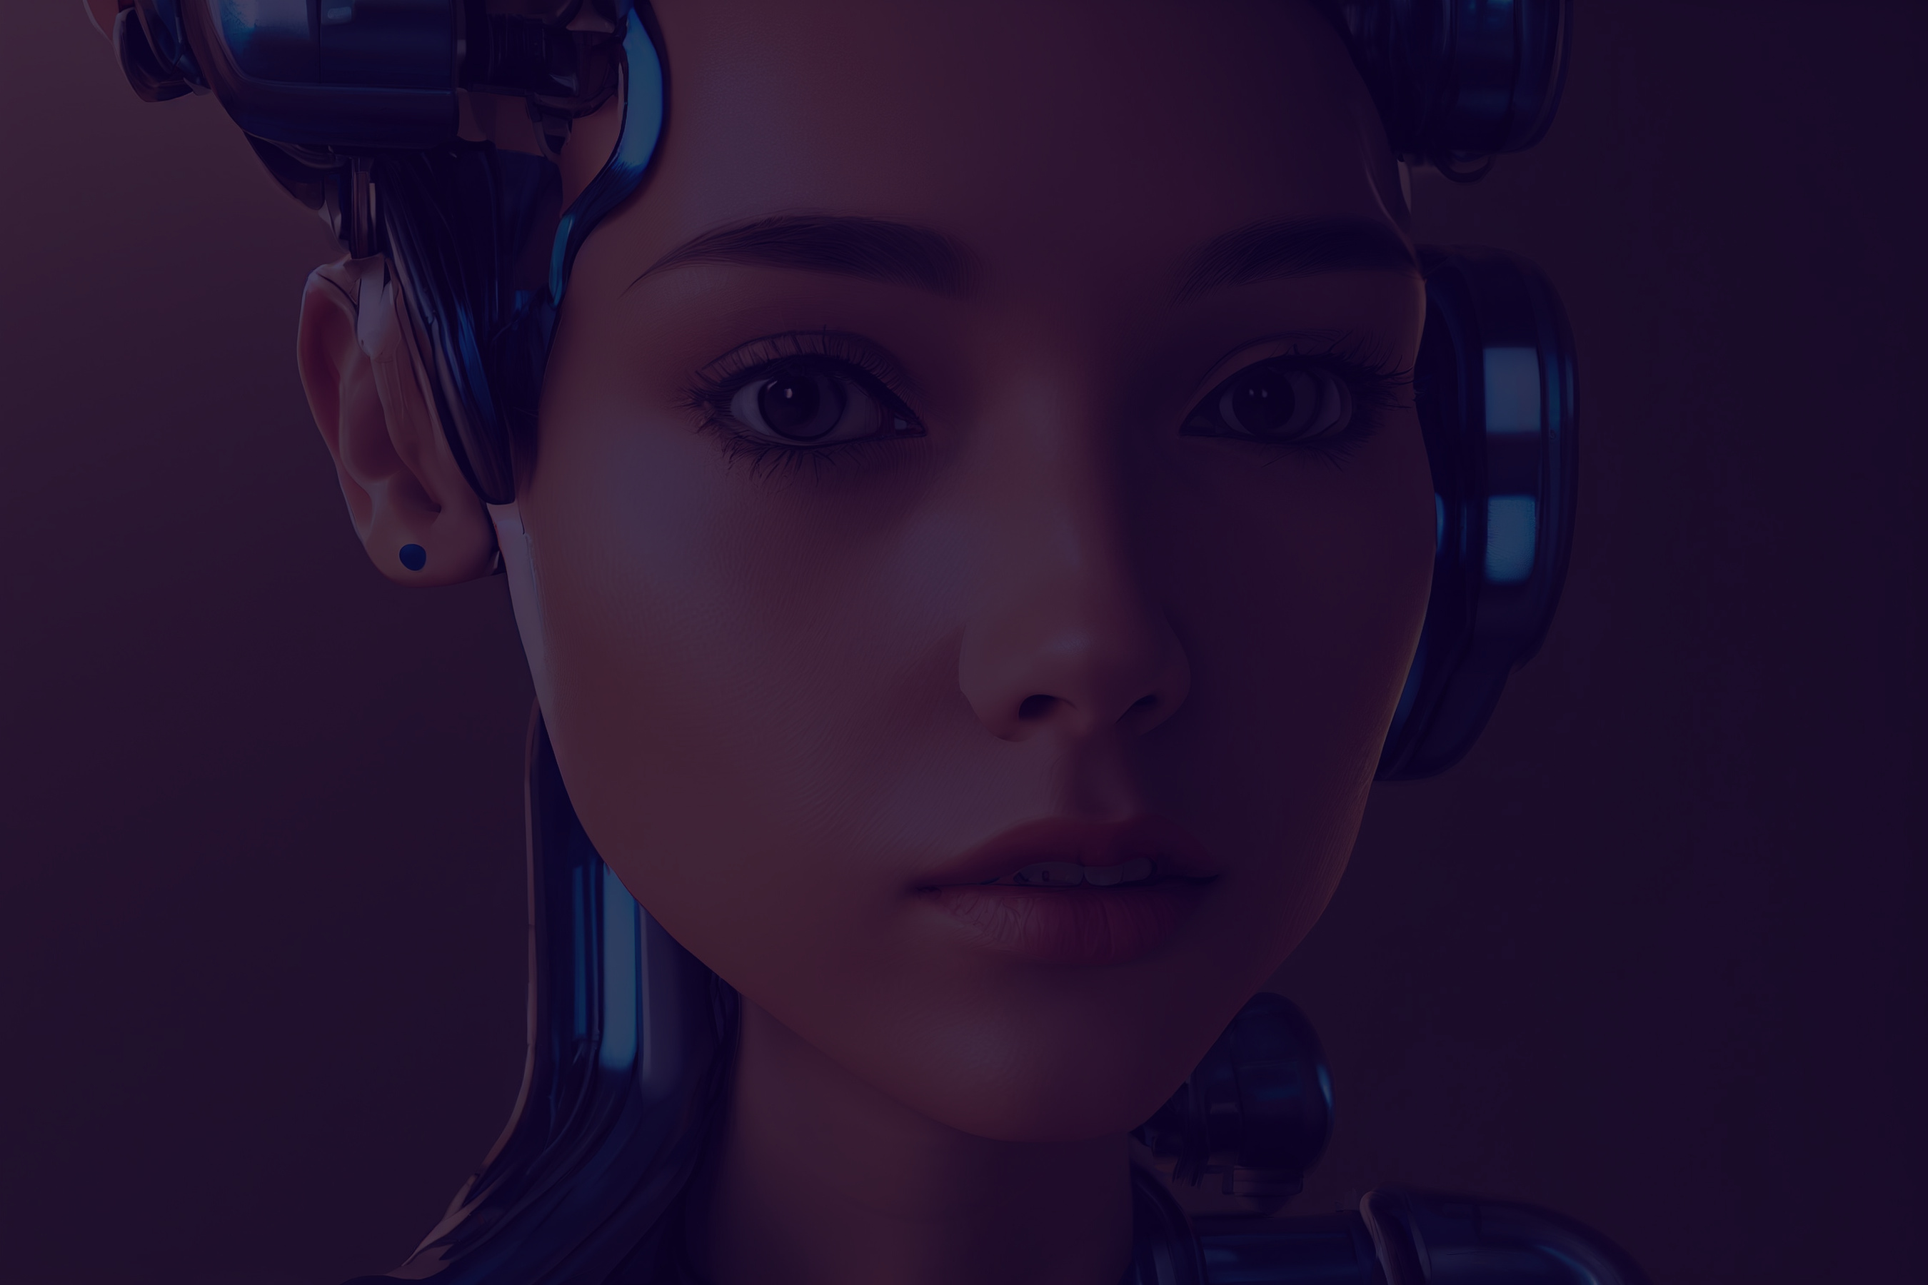
Future updates :
1. Smart Device Integration:
o Control smart home devices like lights or speakers using APIs like Philips
Hue or Google Home.
o Example: "Turn off the lights."
3. Sentiment Analysis:
o Add sentiment analysis to respond to user emotions.
o Example: If the user seems sad, offer encouraging responses.
4. Multi-language Support:
o Extend the assistant to support multiple languages using libraries like
Google Translate API.
o Example: Recognize and respond in French or Spanish.

Slide 9



Thank You!

